Slide 1
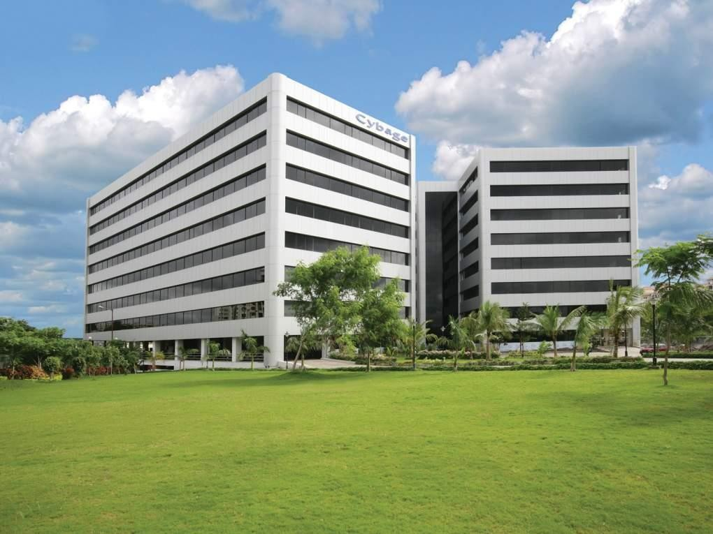


www.cybage.com
SASS – Future of Stylesheet
Authored & Presented by: Asha Bhat
This document and all its contents contain information from Cybage Software Private Limited which may be privileged, confidential, or otherwise protected from disclosure. The information is intended to be for the addressee(s) only. Any unauthorized disclosure, copy, distribution, or use of the contents of this message is strictly prohibited.
Copyright © 2015. Cybage Software Pvt. Ltd. All Rights Reserved. Cybage Confidential.

Slide 2
A
Quick Question – Why are you
here?
•
•
•
•
I don’t know and I think you don’t know either
May be to understand the FET part
May be your bosses has nominated you
Understand the complexity faced by engineers on FET
•
•
Who has heard of SASS?
Who has used SASS?
2
Copyright © 2015. Cybage Software Pvt. Ltd. All Rights Reserved. Cybage Confidential.

Slide 3

www.cybage.com
Agenda
•
•
•
•
•
CSS Today
Introduction to SASS
Features of SASS
How to use SASS
Demo
Copyright © 2015. Cybage Software Pvt. Ltd. All Rights Reserved. Cybage Confidential.
3
Copyright © 2015. Cybage Software Pvt. Ltd. All Rights Reserved. Cybage Confidential.

Slide 4
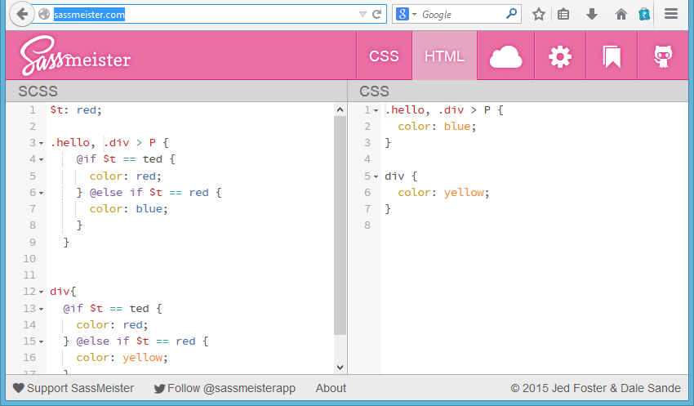
www.cybage.com
Live Testing
You can test out SASS during this presentation!
Use: http://sassmeister.com/
4
Copyright © 2015. Cybage Software Pvt. Ltd. All Rights Reserved. Cybage Confidential.

Slide 5
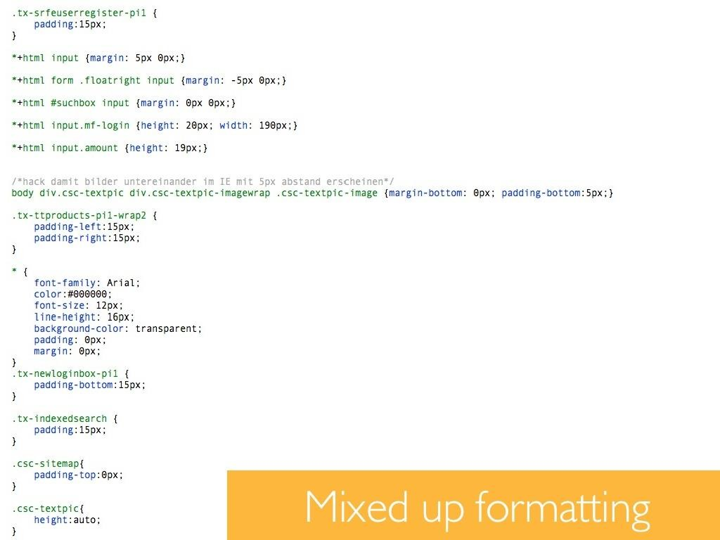
www.cybage.com
CSS
Today
5
Copyright © 2015. Cybage Software Pvt. Ltd. All Rights Reserved. Cybage Confidential.

Slide 6
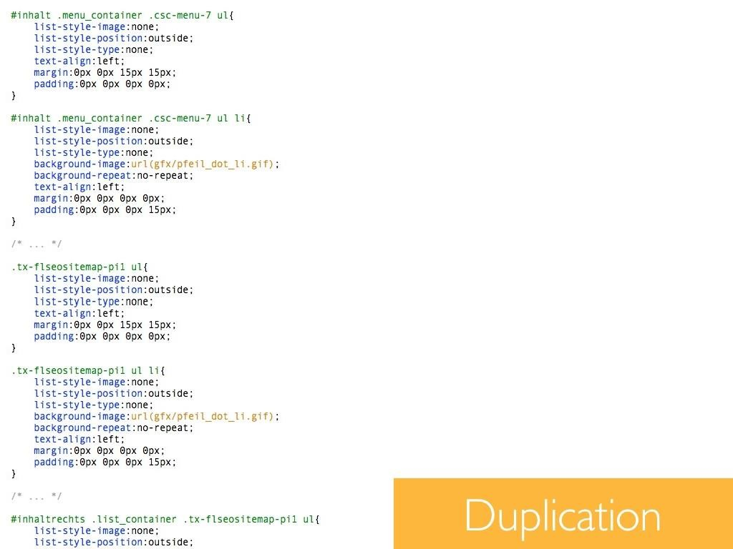
www.cybage.com
CSS
Today
6
Copyright © 2015. Cybage Software Pvt. Ltd. All Rights Reserved. Cybage Confidential.

Slide 7
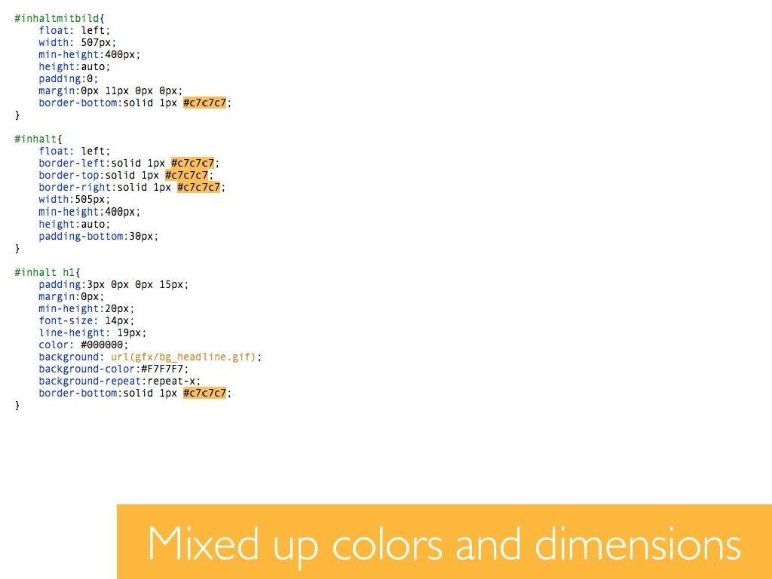
www.cybage.com
CSS
Today
7
Copyright © 2015. Cybage Software Pvt. Ltd. All Rights Reserved. Cybage Confidential.

Slide 8
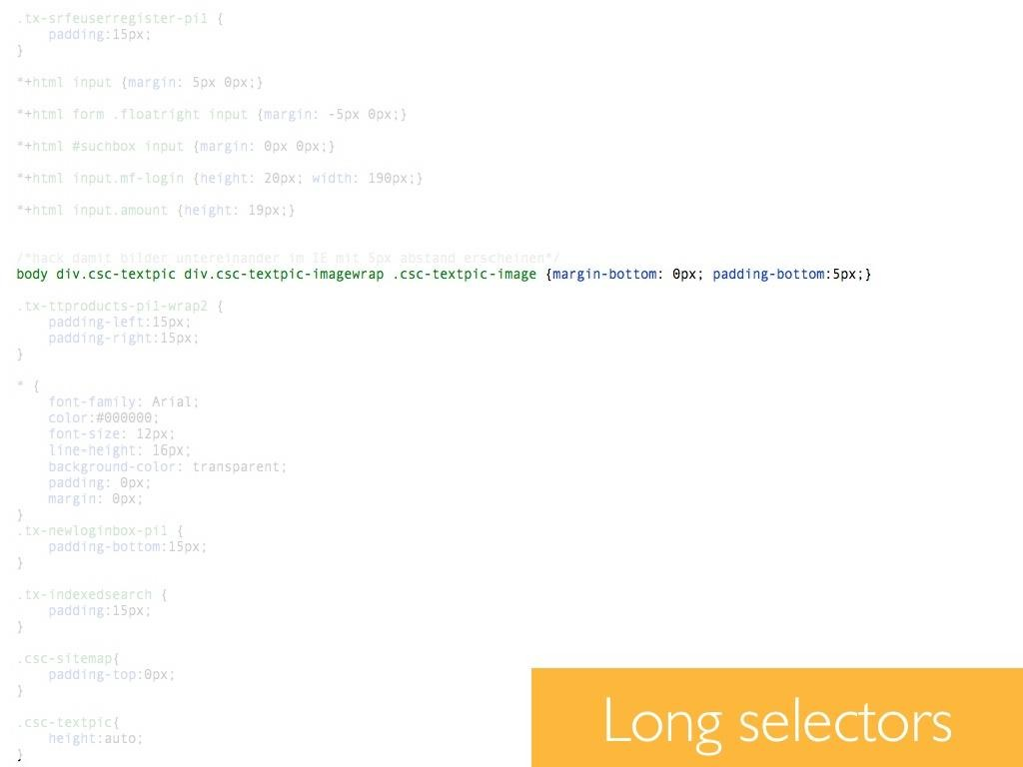
www.cybage.com
CSS
Today
8
Copyright © 2015. Cybage Software Pvt. Ltd. All Rights Reserved. Cybage Confidential.

Slide 9
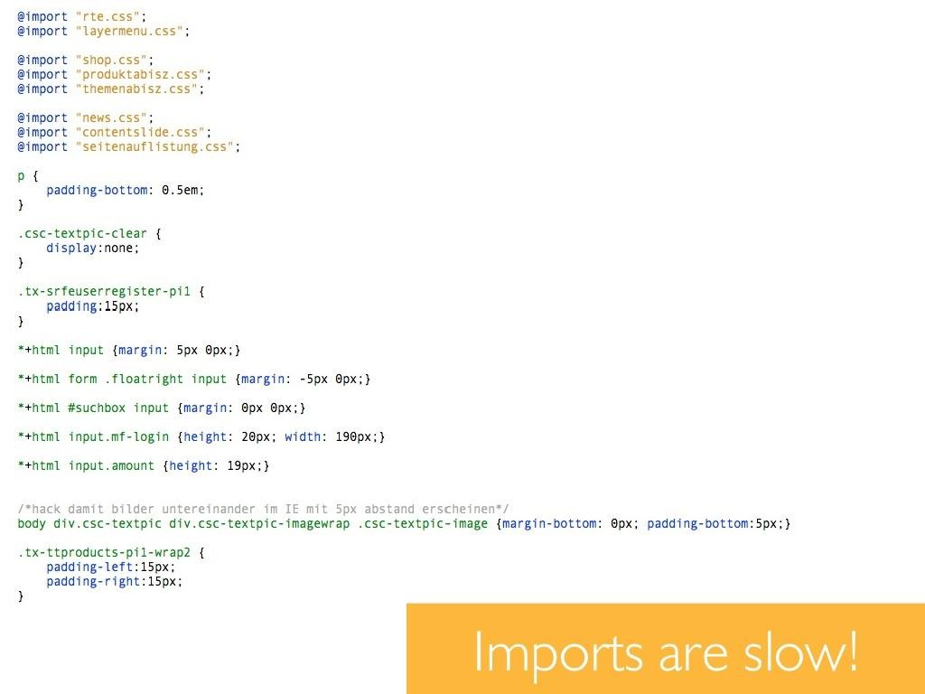
www.cybage.com
CSS
Today
9
Copyright © 2015. Cybage Software Pvt. Ltd. All Rights Reserved. Cybage Confidential.

Slide 10
www.cybage.com
CSS Today
The Good, The Bad & The Cry for Help…!!!
• Frustration
• Vendor specific prefixes
• Replacing color values in a project
• Copying and pasting style again and again
• Media queries
• 3D Animations
Actually features are now becoming nightmare of developers life!
10
Copyright © 2015. Cybage Software Pvt. Ltd. All Rights Reserved. Cybage Confidential.

Slide 11
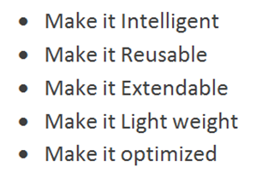
www.cybage.com
What you could
have
done
to
improve
it?
So how to do it?
12
Copyright © 2015. Cybage Software Pvt. Ltd. All Rights Reserved. Cybage Confidential.

Slide 12

www.cybage.com
Copyright © 2015. Cybage Software Pvt. Ltd. All Rights Reserved. Cybage Confidential.
Intro to SASS
(Style
with
attitude)
13
Copyright © 2015. Cybage Software Pvt. Ltd. All Rights Reserved. Cybage Confidential.

Slide 13

www.cybage.com
History
Syntactically Awesome Stylesheets
• Firstly developed in 2007
• Born in the Ruby and Rails Community
SASS has two main parts
• Scripting language
• Preprocessor for CSS
SASS is a system
that extends CSS
and organized.
and
can
make
your
CSS more
eﬃcient
14
Copyright © 2015. Cybage Software Pvt. Ltd. All Rights Reserved. Cybage Confidential.

Slide 14
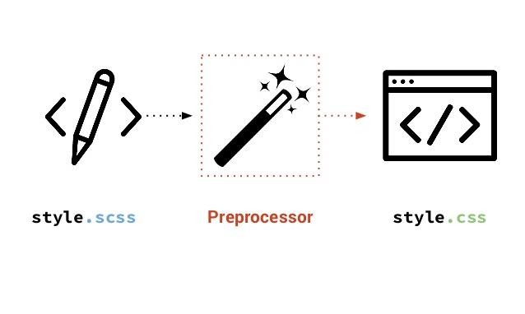
www.cybage.com
How
does
it
works?
16
Copyright © 2015. Cybage Software Pvt. Ltd. All Rights Reserved. Cybage Confidential.

Slide 15
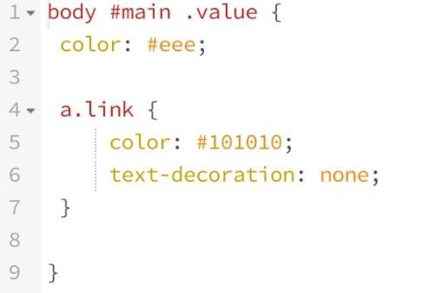
www.cybage.com
.SCSS (SassyCSS)
SCSS follows conventions of CSS
•
•
•
Superset of CSS syntax and uses brackets
and
semicolons.
SCSS Stylesheets get an
.scss
extension.
Most
commonly
used.
17
Copyright © 2015. Cybage Software Pvt. Ltd. All Rights Reserved. Cybage Confidential.

Slide 16
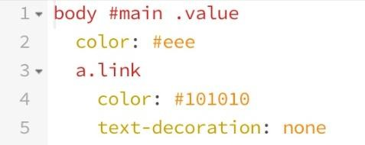
www.cybage.com
.SASS (The Indented Syntax)
SASS focuses on indentation and short-hand.
•
•
•
Instead of brackets and semicolons, it uses indentation of lines to specify blocks of code.
SassScript stylesheets get a .sass extension.
Older syntax.
A
project
would
normally
only
use
one
of
the
two
syntaxes.
18
Copyright © 2015. Cybage Software Pvt. Ltd. All Rights Reserved. Cybage Confidential.

Slide 17
www.cybage.com
Tools Used – (sass-lang.com)
•
Compilation tools
• SASS, Compass – Requires Ruby
•
SASS/Compass GUI tools
•
•
•
Scout (open source)
Koala (open source)
Compass.app (USD 10)
19
Copyright © 2015. Cybage Software Pvt. Ltd. All Rights Reserved. Cybage Confidential.

Slide 18
www.cybage.com
Features / Enhancements
SASS has 5 primary features
•
•
•
•
•
Variables
Nesting
Mixins
Partials
Inheritance
20
Copyright © 2015. Cybage Software Pvt. Ltd. All Rights Reserved. Cybage Confidential.

Slide 19
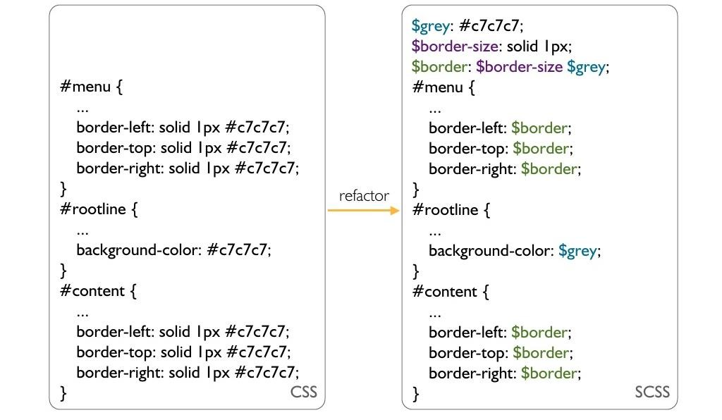
www.cybage.com
Variables
21
Copyright © 2015. Cybage Software Pvt. Ltd. All Rights Reserved. Cybage Confidential.

Slide 20
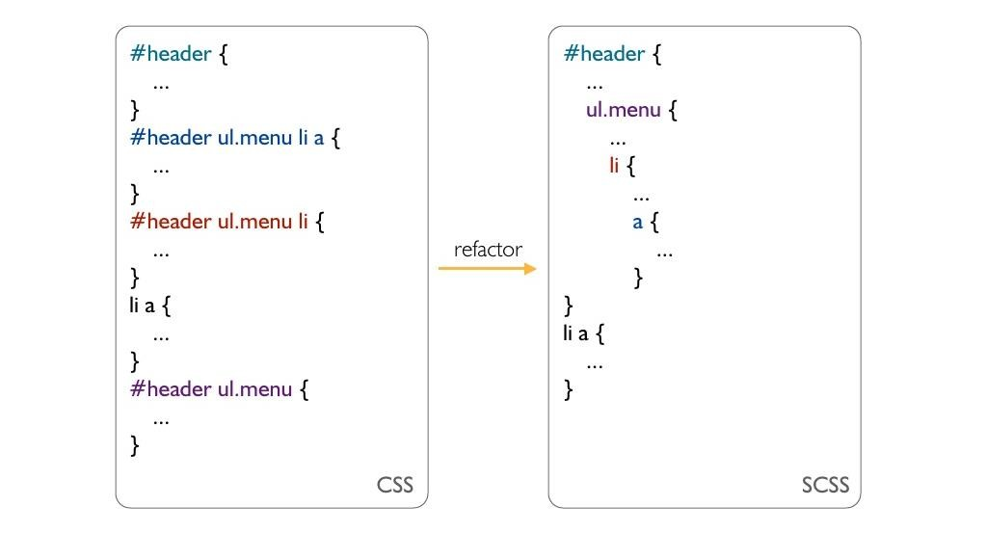
www.cybage.com
Nesting
22
Copyright © 2015. Cybage Software Pvt. Ltd. All Rights Reserved. Cybage Confidential.

Slide 21
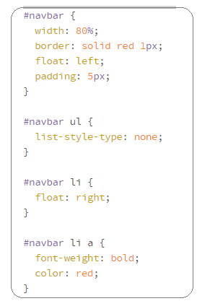
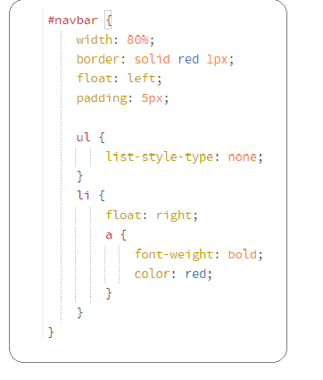
www.cybage.com
Try writing SASS
SCSS
22
Copyright © 2015. Cybage Software Pvt. Ltd. All Rights Reserved. Cybage Confidential.

Slide 22
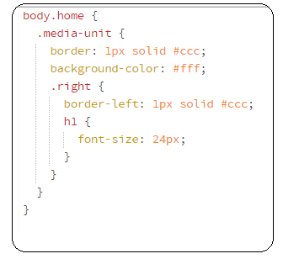
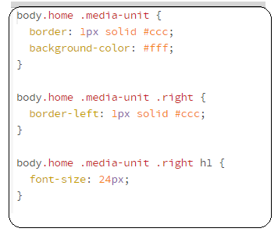
www.cybage.com
Guess the output??
CSS
22
Copyright © 2015. Cybage Software Pvt. Ltd. All Rights Reserved. Cybage Confidential.

Slide 23
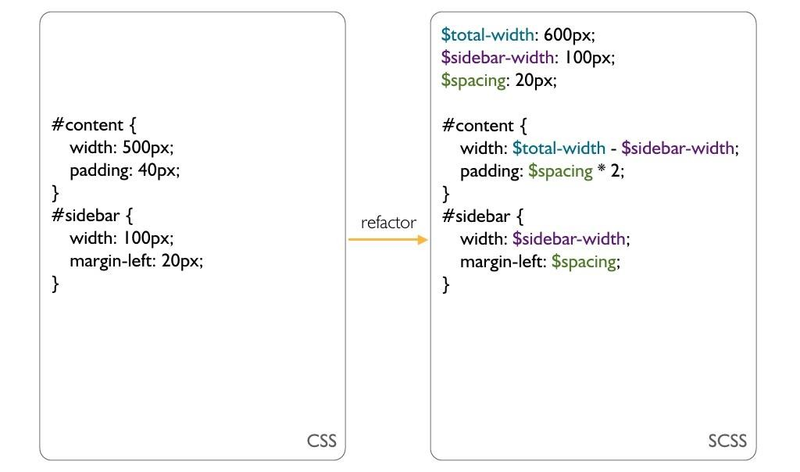
www.cybage.com
Calculations
23
Copyright © 2015. Cybage Software Pvt. Ltd. All Rights Reserved. Cybage Confidential.

Slide 24
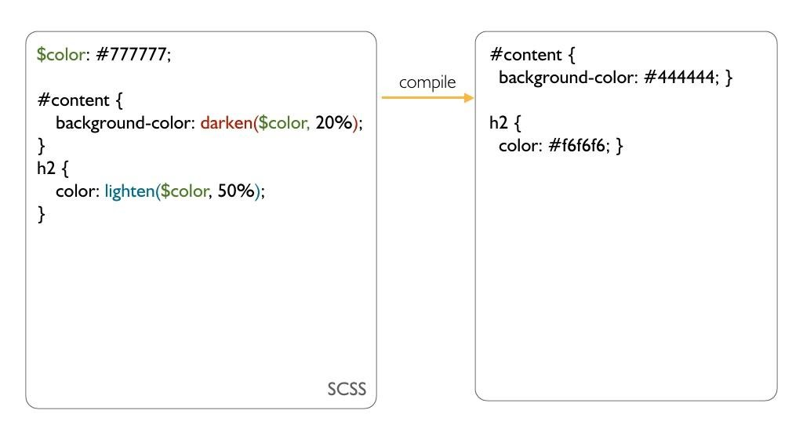
www.cybage.com
Predefined
Functions
24
Copyright © 2015. Cybage Software Pvt. Ltd. All Rights Reserved. Cybage Confidential.

Slide 25
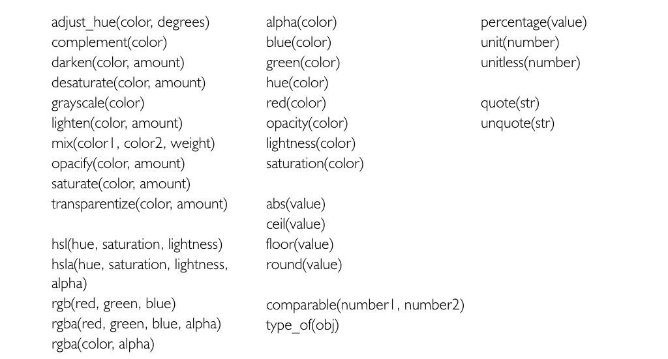
www.cybage.com
Predefined Functions
http://sass-lang.com/documentation/Sass/Script/Functions.html
25
Copyright © 2015. Cybage Software Pvt. Ltd. All Rights Reserved. Cybage Confidential.

Slide 26
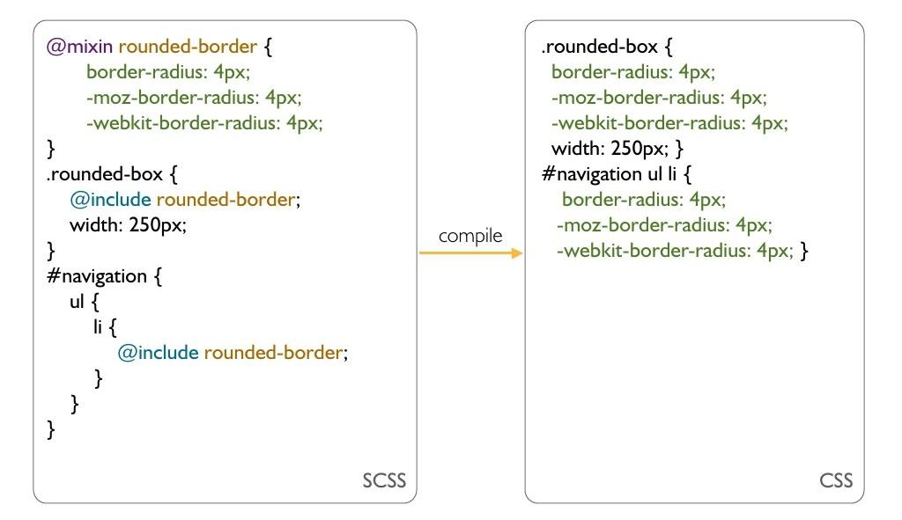
www.cybage.com
Mixins
26
Copyright © 2015. Cybage Software Pvt. Ltd. All Rights Reserved. Cybage Confidential.

Slide 27
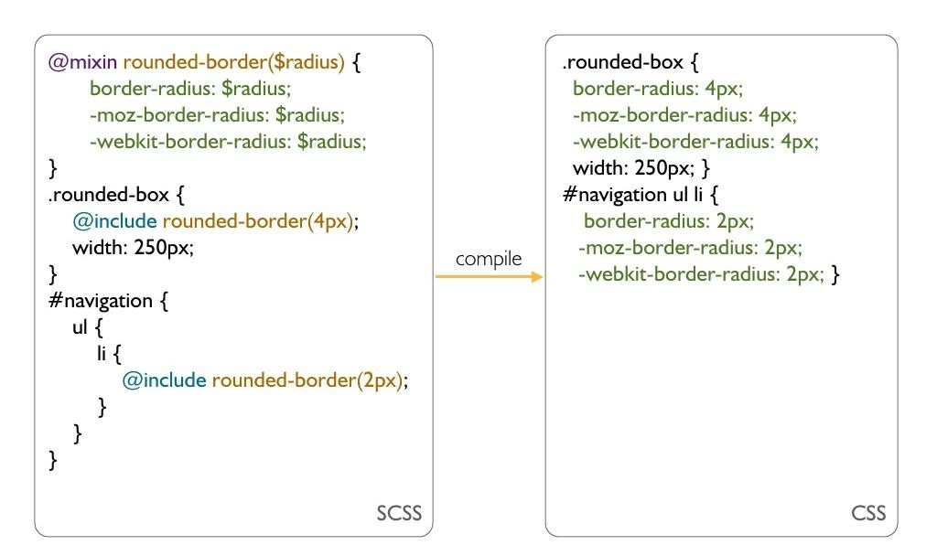
www.cybage.com
Mixins
with
Arguments
27
Copyright © 2015. Cybage Software Pvt. Ltd. All Rights Reserved. Cybage Confidential.

Slide 28
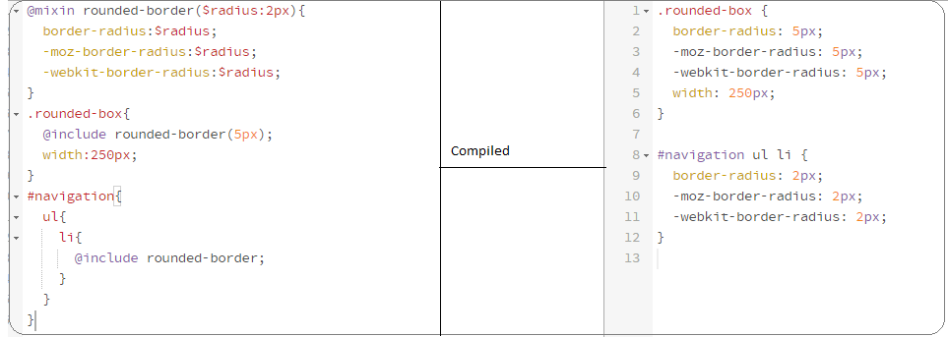
www.cybage.com
Mixins
with
default values
27
Copyright © 2015. Cybage Software Pvt. Ltd. All Rights Reserved. Cybage Confidential.

Slide 29
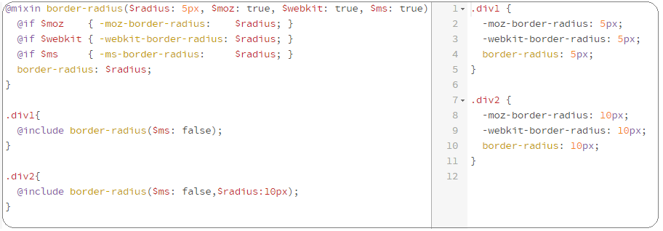
www.cybage.com
Mixins
with
Keyword arguments
27
Copyright © 2015. Cybage Software Pvt. Ltd. All Rights Reserved. Cybage Confidential.

Slide 30
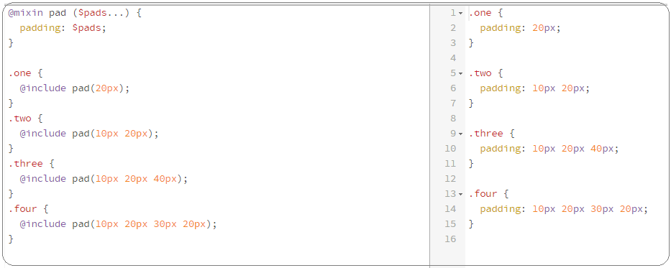
www.cybage.com
Mixins
with
Variable Arguments
27
Copyright © 2015. Cybage Software Pvt. Ltd. All Rights Reserved. Cybage Confidential.

Slide 31
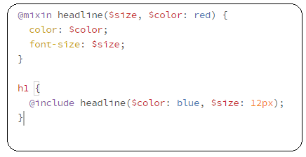
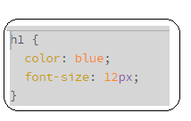
www.cybage.com
Try this
SCSS
26
Copyright © 2015. Cybage Software Pvt. Ltd. All Rights Reserved. Cybage Confidential.

Slide 32
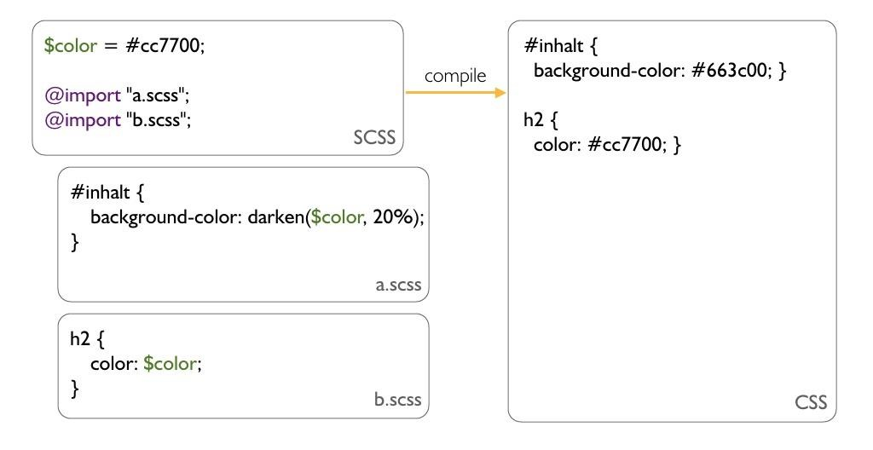
www.cybage.com
Partials
28
Copyright © 2015. Cybage Software Pvt. Ltd. All Rights Reserved. Cybage Confidential.

Slide 33
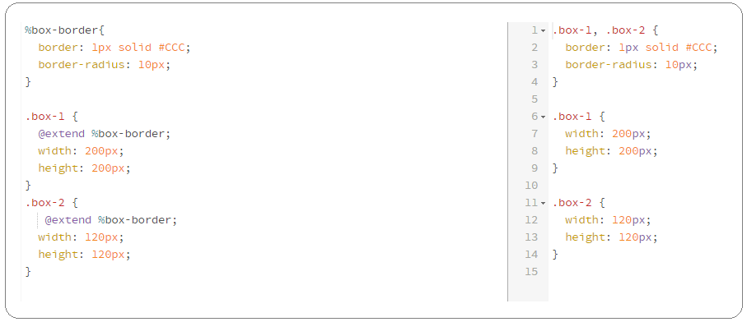
www.cybage.com
Inheritance
28
Copyright © 2015. Cybage Software Pvt. Ltd. All Rights Reserved. Cybage Confidential.

Slide 34
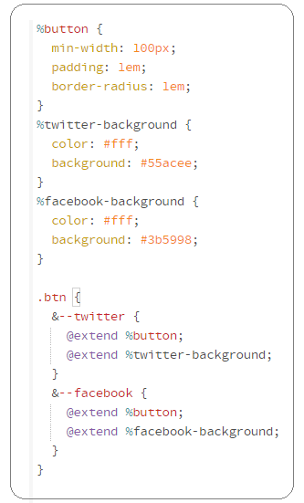
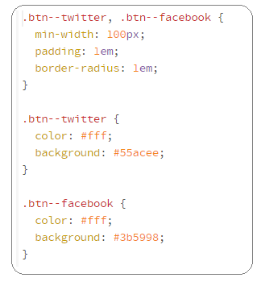
www.cybage.com
Try SASS inheritance
SCSS
28
Copyright © 2015. Cybage Software Pvt. Ltd. All Rights Reserved. Cybage Confidential.

Slide 35
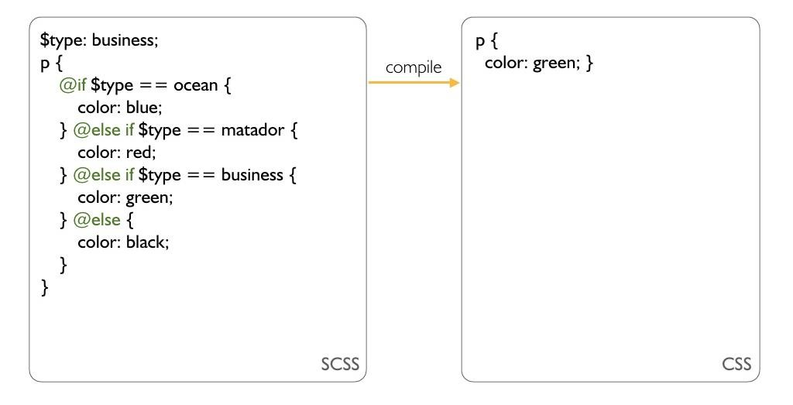
www.cybage.com
Control
Structures
-
if
29
Copyright © 2015. Cybage Software Pvt. Ltd. All Rights Reserved. Cybage Confidential.

Slide 36
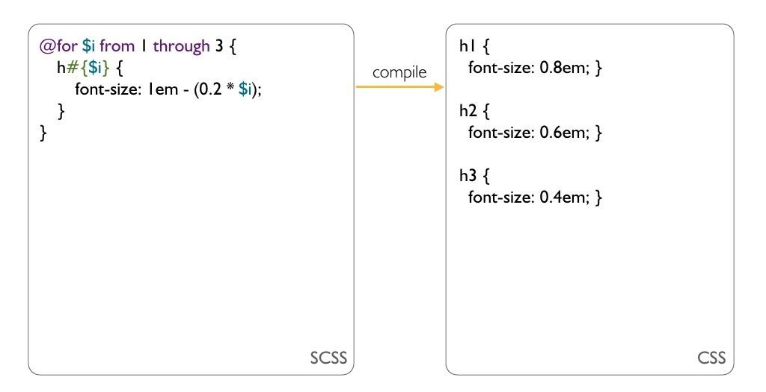
www.cybage.com
Control
Structures
-
for
30
Copyright © 2015. Cybage Software Pvt. Ltd. All Rights Reserved. Cybage Confidential.

Slide 37
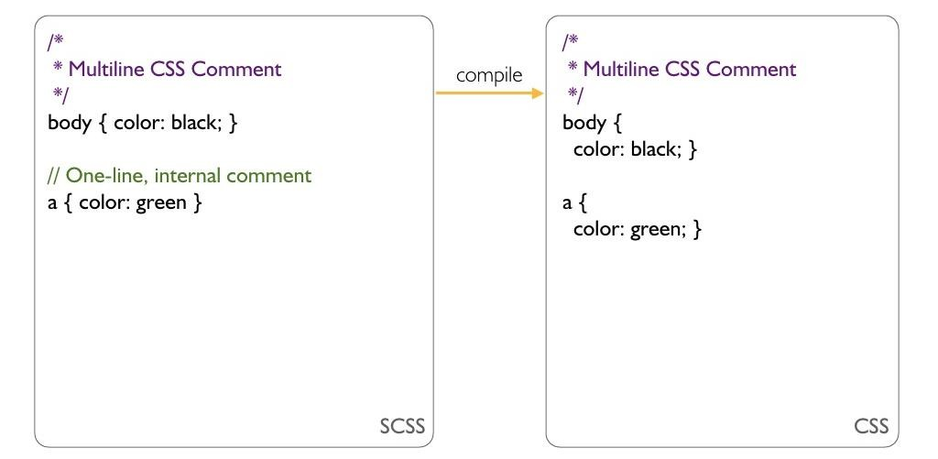
www.cybage.com
Comments
31
Copyright © 2015. Cybage Software Pvt. Ltd. All Rights Reserved. Cybage Confidential.

Slide 38
www.cybage.com
Sass Installation
Tools
• SASS
• Compass
• Ruby
31
Copyright © 2015. Cybage Software Pvt. Ltd. All Rights Reserved. Cybage Confidential.

Slide 39
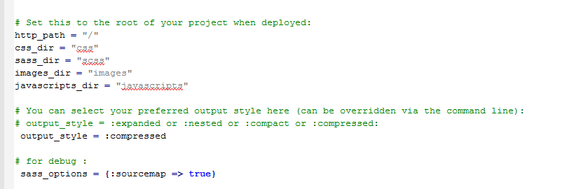
www.cybage.com
Config.rb
31
Copyright © 2015. Cybage Software Pvt. Ltd. All Rights Reserved. Cybage Confidential.

Slide 40
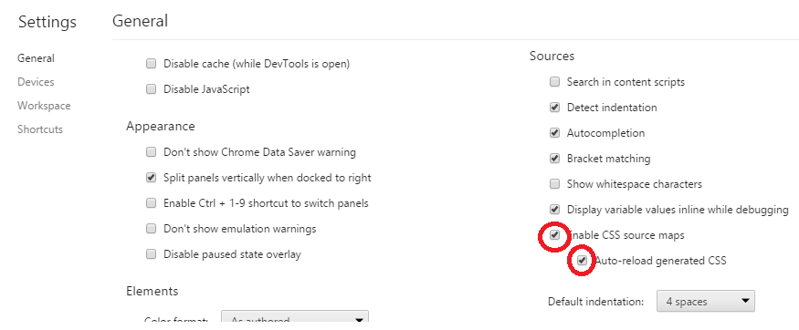
www.cybage.com
Debug Sass
developers tools --> settings → general → source
31
Copyright © 2015. Cybage Software Pvt. Ltd. All Rights Reserved. Cybage Confidential.

Slide 41
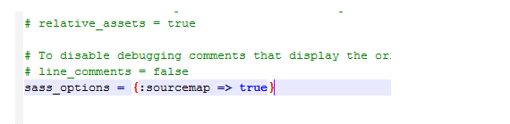
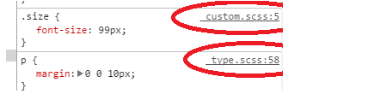
www.cybage.com
Debug Sass
31
Copyright © 2015. Cybage Software Pvt. Ltd. All Rights Reserved. Cybage Confidential.

Slide 42
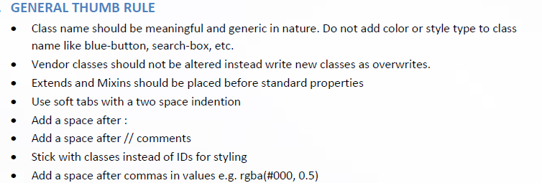
www.cybage.com
Best practices
31
Copyright © 2015. Cybage Software Pvt. Ltd. All Rights Reserved. Cybage Confidential.

Slide 43
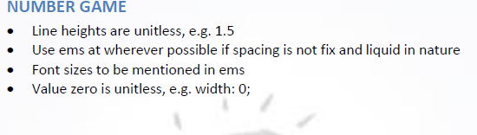
www.cybage.com
Best practices
31
Copyright © 2015. Cybage Software Pvt. Ltd. All Rights Reserved. Cybage Confidential.

Slide 44
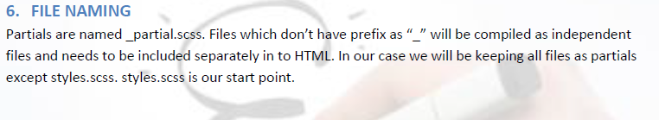
www.cybage.com
Best practices
31
Copyright © 2015. Cybage Software Pvt. Ltd. All Rights Reserved. Cybage Confidential.

Slide 45
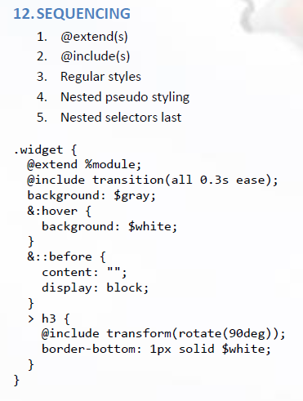
www.cybage.com
Best practices
31
Copyright © 2015. Cybage Software Pvt. Ltd. All Rights Reserved. Cybage Confidential.

Slide 46
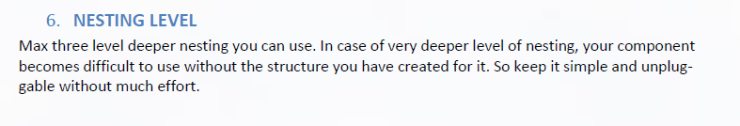
www.cybage.com
Best practices
31
Copyright © 2015. Cybage Software Pvt. Ltd. All Rights Reserved. Cybage Confidential.

Slide 47
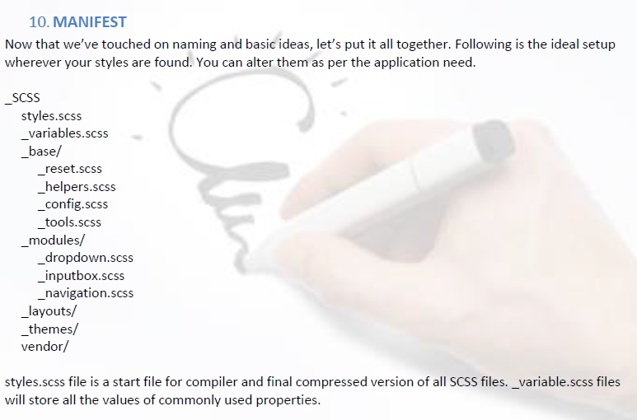
www.cybage.com
Ideal Folder structure
31
Copyright © 2015. Cybage Software Pvt. Ltd. All Rights Reserved. Cybage Confidential.

Slide 48

www.cybage.com
Copyright © 2015. Cybage Software Pvt. Ltd. All Rights Reserved. Cybage Confidential.
Thank You!
Copyright © 2015. Cybage Software Pvt. Ltd. All Rights Reserved. Cybage Confidential.

